Slide 1


[]

Slide 2


Today's agenda
Project recap
Problem
The Analytics team
Process
Insights
Summary

Slide 3

To start our engagement with Social Buzz, we are running a 3-month initial project to prove to them that we are the best firm to work with. They are expecting the following:
-An audit of their big data practice
- Recommendations for a successful IPO
-An analysis of their content categories that highlights the top 5 categories with the largest aggregate popularity
Project Recap

Slide 4

Problem
over 100,000 pieces of content every day
36,500,000 content per year
Data Management Challenges ??
Find the Top 5 categories of content from the dataset.

Slide 5



Andrew Fleming
(Chief Technical Architect)
The Analytics team
Marcus Rompton
(Senior Principle)
Gaurav Singh
(Data Analyst)

Slide 6
Process
1
Data understanding
Data Cleaning
2
Data Modeling
3
Data Analysis
4
5
Uncover Insights

Slide 7
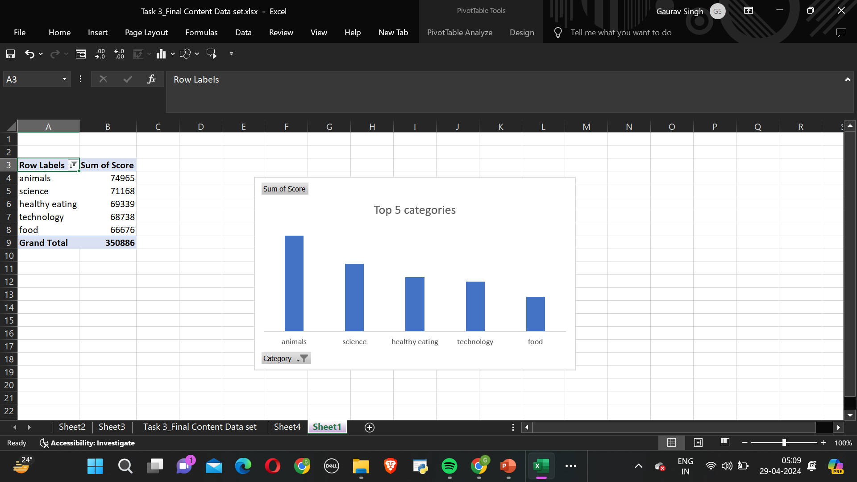

Insights

Slide 8
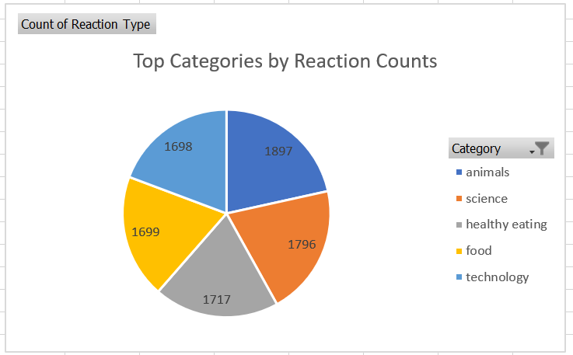

Slide 9
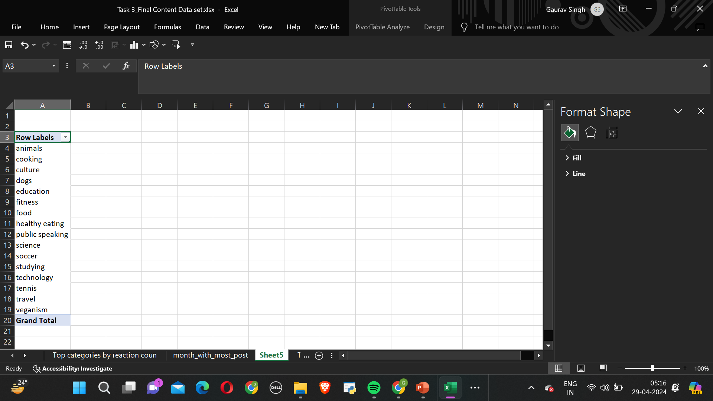
Unique categories
Unique categories

Slide 10
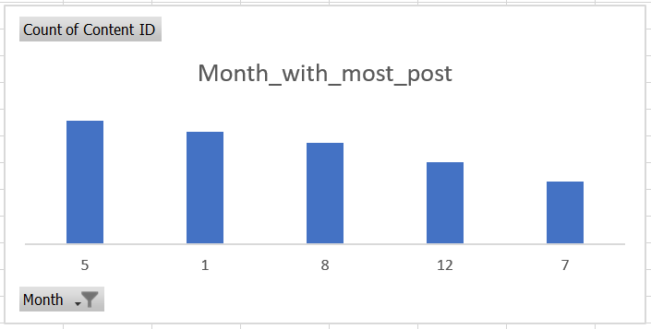
Unique categories

Slide 11

The dataset includes various content categories such as animals, cooking, culture, dogs, education, fitness, food, healthy eating, public speaking, science, soccer, studying, technology, tennis, travel, and veganism.
The top five categories with the highest sum are animals, science, healthy eating, technology, and food.
The month with the most posts is May(2138)
The top five categories with the highest reaction count are animals(1897), science(1796), healthy eating(1717), technology(1699), and food(1698).
Summary

Slide 12
Thank you!
ANY QUESTIONS?

